Slide 1

An Introduction to Watersheds
watershed.uga.edu
Notes:
This presentation is intended to introduced students to what a watershed is, some threats to our watersheds on campus, and

Slide 2
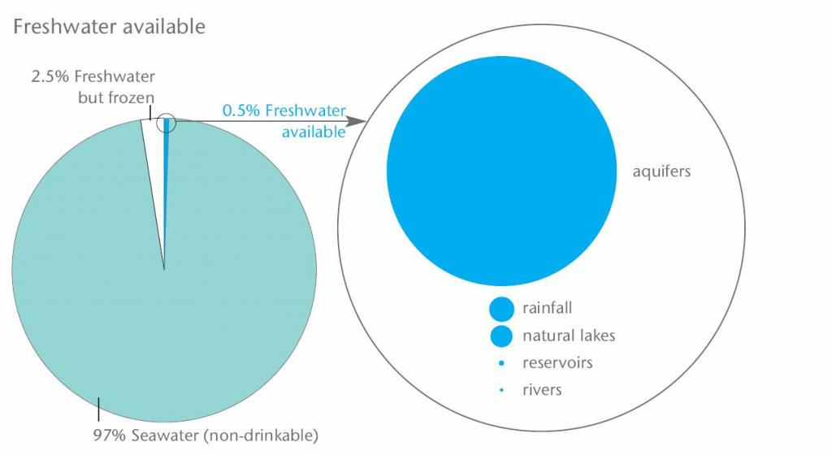
Freshwater is a Limited Resource!
The world’s freshwater resources. Source: WBCSD (2009)
Notes:
While we live on a blue planet, clean, available freshwater is extremely limited!

Slide 3
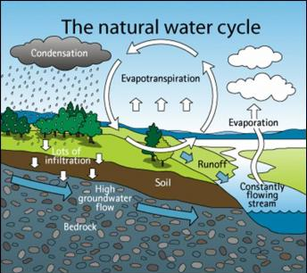
Modified from:
Influences on the water cycle in cities through sealed surfaces. Source: AUCKLAND CITY COUNCIL (2010)
http://www.sswm.info/category/concept/water-cycle
Notes:
Freshwater is continually cycling – it is deposited as precipitation, and collected on the lands surface where it filters down through the soil and into the ground in a process called infiltration. Infiltration allows the water to be temporarily stored under the ground as groundwater, where it may be taken up by plant roots, or flow below the surface until it empties into a surface water body such as a stream or a river, which eventually empties into an ocean. While water is continually cycling, the availability of freshwater varies greatly across seasons, years, and space.
Take a look at the right side of this figure where the groundwater that is flowing underneath the surface collects into a stream. There’s so much interaction between ground water and surface water – the amount of water that is captured by infiltration determines how close this groundwater lies to the surface, and this determines how much water is available to streams.

Slide 4
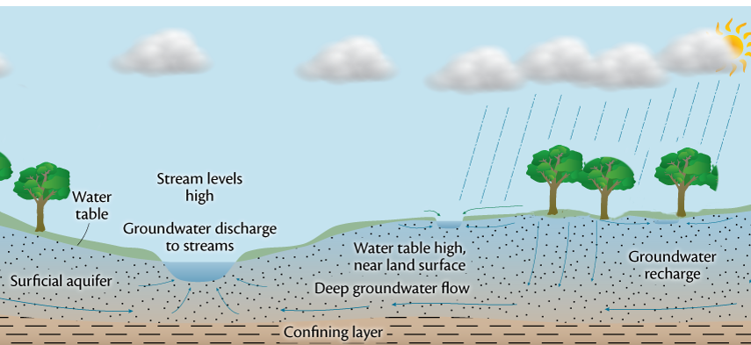
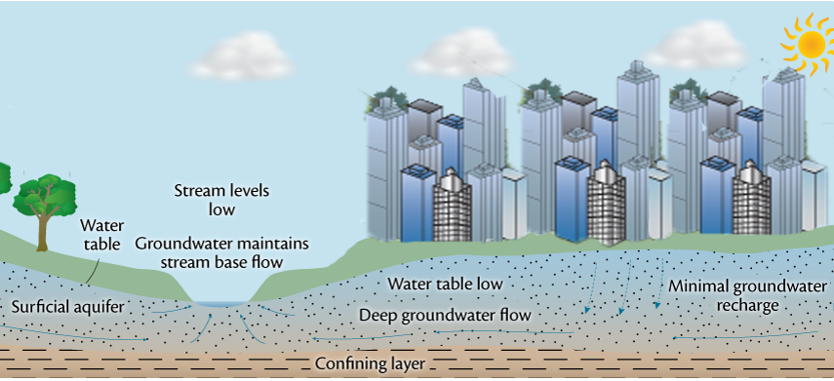
Infiltration
← Natural infiltration leads to a high water table and plenty of water flowing in streams during dry weather
Reduced infiltration leads to a lower water table and lower surface flow in streams during dry weather →
Notes:
When there’s a lot of infiltration of rainwater through the soils, this “re-charges” groundwater levels. When there’s a lot of groundwater flowing below the surface, the water table is high, and streams have a constant source of water between rainfall events, so they can support aquatic life even when it the weather is dry.
If we interrupt the process of groundwater recharge by paving over the surface, the slow infiltration of water into the ground cannot occur, and instead rainwater gets collected from parking lots and buildings into gutters and pipes that empty all of the water into the stream at once. With all of the water shunted quickly across the surface, there’s no groundwater recharge, and the water table goes lower.
Streams rely on groundwater to maintain their “baseline flow”, and some streams are only present when groundwater levels are high enough to intercept small stream channels. For example, only three blocks from here in five points, groundwater that’s flowing near the surface begins to collect into a small stream called Lilly Branch.
Uplands are critical to water composition because these streams tend to have an immediate response to runoff events
These streams tend to flow either in response to storms, seasonal water availability or perennially from groundwater discharge
These streams tend to have simple ecological structure that is dependent on inputs from the surrounding land
Can be easily impacted and altered by human activities in the uplands because of small size
Health of the smaller watersheds is critical to how the larger watersheds will respond to disturbances

Slide 5
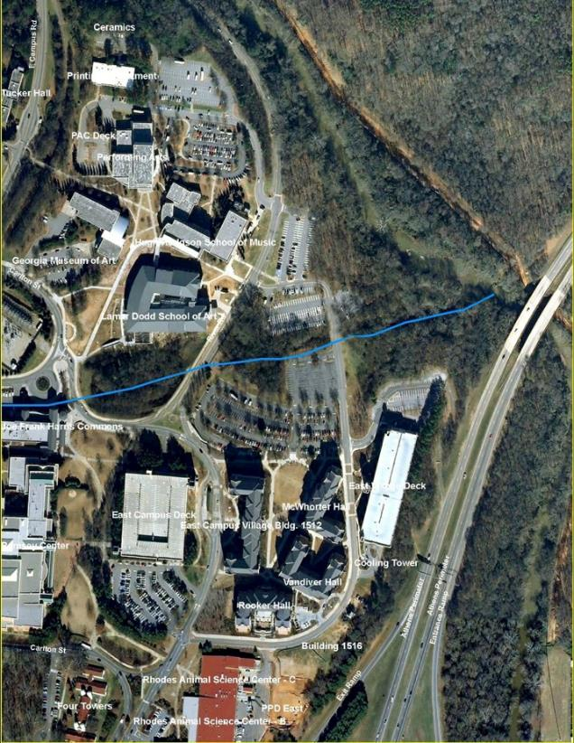
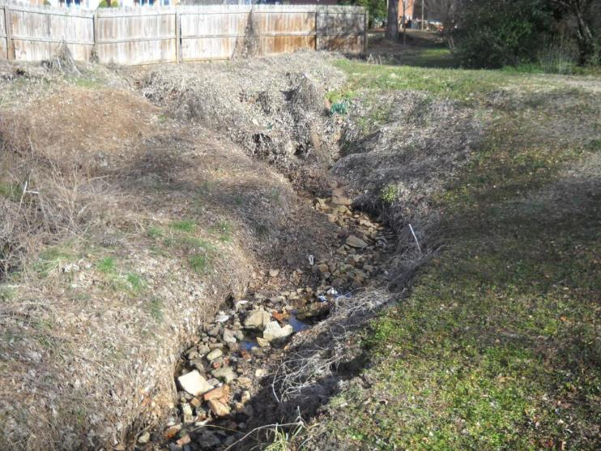
Headwater streams
North Oconee
Lilly Branch
Lilly Branch headwaters
Notes:
Streams like Lilly Branch, pictured here, are called headwater streams because they are the first recognizable flow in a stream system. On the left is a picture of where the stream first starts, and on the right is a picture of where the stream runs above the ground (or day-lights) just before flowing into the Oconee river. Small headwater streams like Lily Branch are particularly sensitive to human activities and development in their uplands that change infiltration rates because these small streams tend to collect water from a relatively small area. Headwater streams continue to drain the upland area around them, then converge with other streams to form larger connected stream systems. These drainage systems are called watersheds!

Slide 6
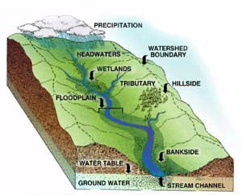
What is a Watershed?
an area of land from which all water drains into a particular stream or river
Notes:
Our supply of water in a given area is influenced by everything else that happens within the watershed. A watershed is an area of land that drains into a particular body of water. Anything happening within that watershed affects the quality and quantity of water in that water body.

Slide 7
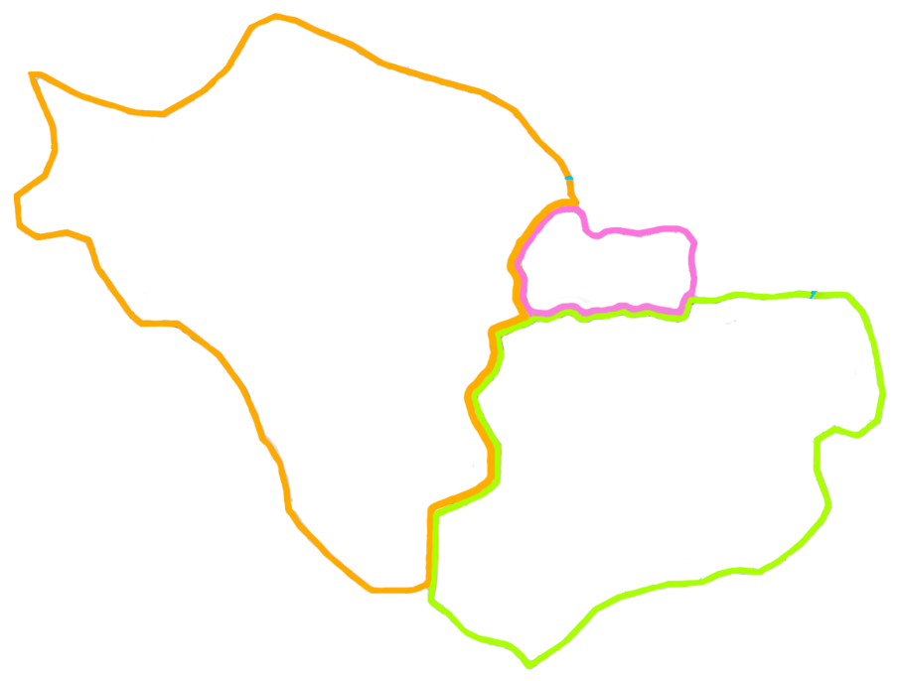
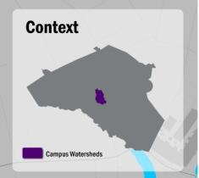
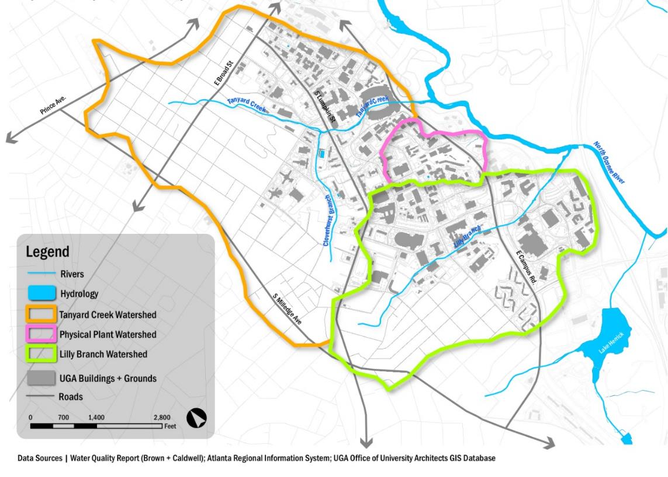
UGA Campus Watersheds
Notes:
Here are the three main watersheds on campus. Tanyard Creek (red arrow) is a small headwater stream which runs though UGA’s North Campus UNDER SANFORD STADIUM (red box) and into the Oconee River. Tanyard Creek is bounded by a particular area of land that drains into it (the orange outline), and this area of land is Tanyard Creek’s watershed. Look at the area marked in green– this is the Lilly Branch watershed. Lilly Branch starts up in Five Points and goes underground at Foley (baseball field). The small area bounded in pink is the Physical Plant watershed. The lighter blue line shows where the streams actually are but keep in mind that in some of these places they are buried underground (like at Sanford Stadium and Foley Field).

Slide 8
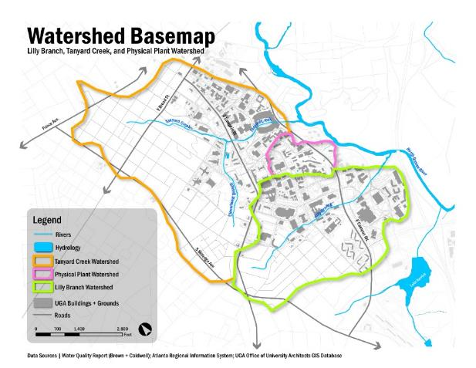
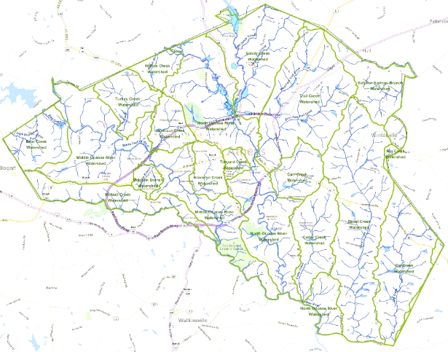
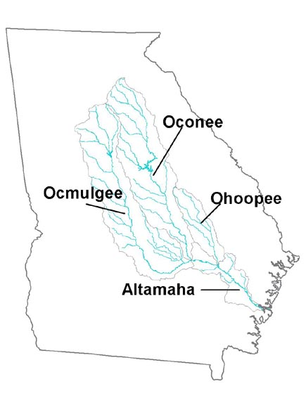
Watersheds at different scales
← Athens-Clarke county watersheds
UGA campus
watersheds
Greater Altamaha Watershed System →
Notes:
Here you can see the different scales of watersheds. In the map in the middle, Athens-Clarke County is marked by the green line. We can see that Tanyard Creek watershed (upper left campus map) is one of many small watersheds within Athens-Clarke County that drain into the Upper Oconee watershed.
At an even larger scale, we can see that the Upper Oconee joins with the lower Oconee to make the Oconee River watershed, which joins the Ocmulgee and Ohoopee watersheds to make the Altamaha River watershed. The Altamaha eventually drains into the Atlantic Ocean.
Water is a great connector of habitats and people. What does Tanyard Creek on UGA’s north campus have in common with the Georgia coast? The water that starts here ends up down in the coastal marshes, supporting a diversity of fish and other organisms that use these habitats as nursery grounds, or who use them as rest stops on long migrations. In route, that water is used by many people and organisms. We’ll talk about the specifics of that in just a minute. Everything in a watershed is connected by the water! And most everyone lives downstream!

Slide 9
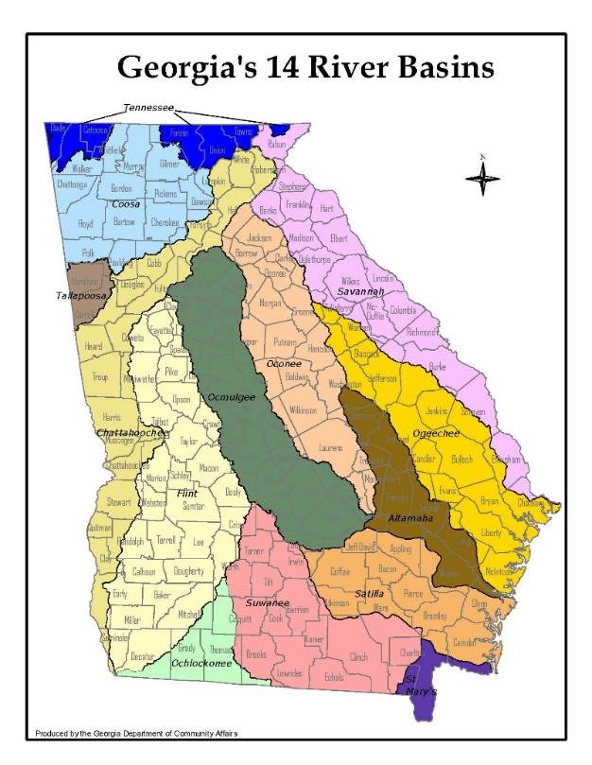
Major watersheds in Georgia
Notes:
Here’s a map showing the 14 major watersheds in Georgia, which are also known as Georgia’s 14 river basins . Note the Oconee watershed. You’ll also see the Chattahoochee, Flint and Savannah watersheds here among others.

Slide 10
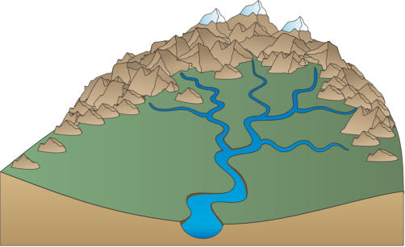
The shape of the land…
determines the boundaries of the watershed
determines how much water is collected during a rainfall event
is a product of the underlying geology (ie. the kinds of rock, their shape, and how they’ve changed through time)
http://ian.umces.edu/imagelibrary/displayimage-6226.html
Notes:
The boundaries of the watershed for a given stream or river are defined by the topography or shape of the surrounding land, which determines how much water is collected during precipitation events (ie. how big is the bowl?), and which watershed it drains into. This topography or shape is itself a product of the geological history of the land.
Great additional resource on Watersheds and geology: http://coastgis.marsci.uga.edu/summit/k12geology.htm

Slide 11
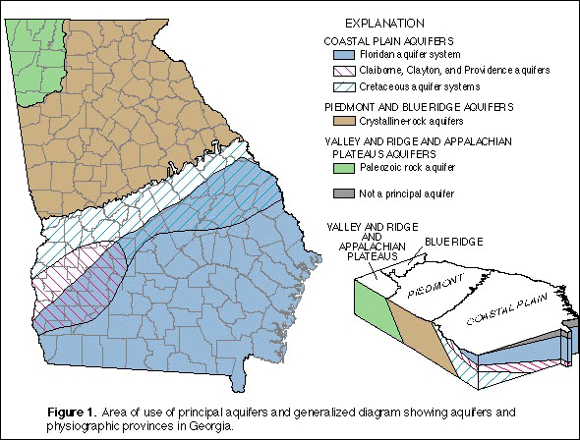
The underlying geology…
determines how the water that is collected in a certain watershed will be filtered and stored.
Our location in the GA Piedmont means that most of the water we use comes from surface waters like streams, rivers, and man-made lakes (reservoirs) rather than from groundwater
Notes:
The underlying geology also determines how the water that is collected in a certain watershed will be filtered and stored.
For example, Athens in located in the Piedmont region of Georgia. The rich clay-heavy soil and hard crystalline rock below does not allow much water to soak into the ground when it rains, and the hilly landscape means that water runs more quickly downhill. In the ancient crystalline rock that underlays the Piedmont region, there’s not much space between the microscopic mineral crystals, so this crystalline-rock does not act as a very effective kind of aquifer, and it does not store very much water. Therefore, in the Piedmont region, most of our rainwater flows into streams and rivers, instead of being stored underground.
In the flatter southern part of the Altamaha watershed, in Georgia’s Coastal Plain region, water moves more slowly, and drains into the porous sandy soil and limestone. Therefore, in the coastal plain, less rainwater flows into stream channels, and instead, the water is more likely to percolate into and be stored by in the porous aquifers below the ground’s surface (modified from http://coastgis.marsci.uga.edu/summit/k12watersource.htm).
The bottom line is that in Athens, our location in the GA Piedmont means that most of the water we use comes from surface waters like streams, rivers, and man-made lakes (reservoirs) rather than from groundwater.
Source: http://pubs.usgs.gov/sir/2011/5048/pdf/sir2011-5048.pdf

Slide 12
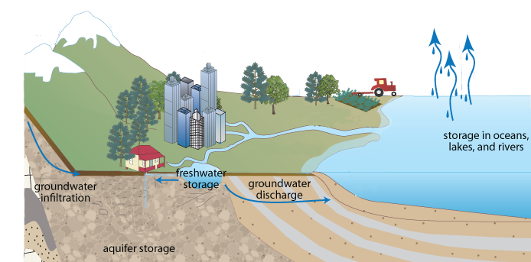

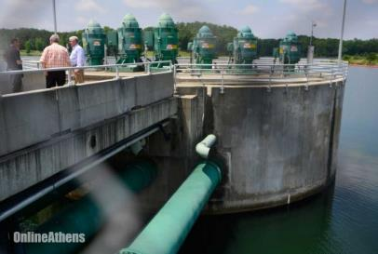
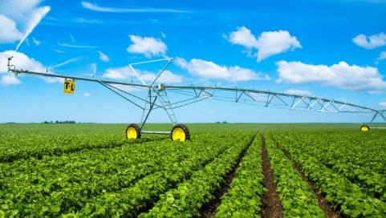
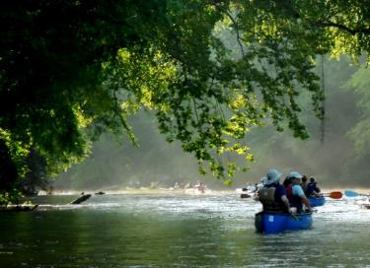
Watershed health
Healthy watersheds provide us a clean and predictable source of water by naturally collecting, filtering and storing it
Notes:
In order for us to have clean streams and a consistent supply of surface water, we need to have healthy watersheds. What is a healthy watershed? A healthy watershed is one where natural processes like the replenishment of groundwater and filtration of rainwater through soils happen without obstruction, providing these important “ecosystem services” for free to everyone who lives in or is connected to the watershed. Healthy watersheds provide us a clean and predictable source of water by naturally collecting, filtering and storing it.
We depend on having clean streams and rivers for everything from drinking water, to irrigation, to supporting industrial uses, providing habitats for plant and animals and recreation opportunities for us.
Irrigation: http://georgiapivots.com/other-services/
Paddling: https://garivernetwork.wordpress.com/2011/06/27/paradise-found-paddle-georgia-2011-on-the-oconee/
Reservoir: http://onlineathens.com/local-news/2013-10-20/state-revisits-interbasin-transfers-worries-environmentalists

Slide 13
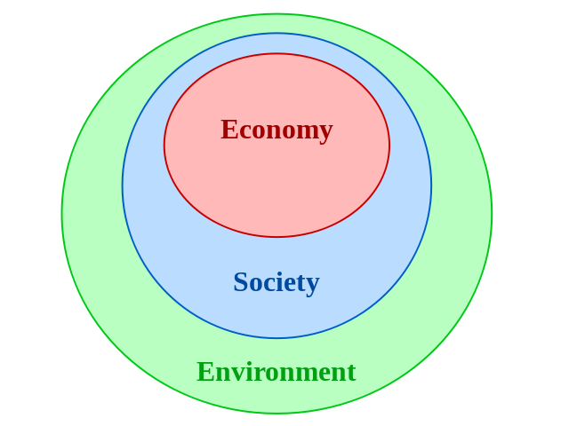
Clean Water = Sustainable Future
Being sustainable means meeting the needs of the present without compromising the ability of future generations to meet their needs
"Nested sustainability-v2" by KTucker - Own work. Licensed under CC BY-SA 3.0 via Wikimedia Commons
Notes:
Because our freshwater supply is always limited, and because we depend on water in every aspect of our lives, it’s critical that we manage our water resources sustainably.
What is sustainability? Being sustainable means meeting the needs of the present without compromising the ability of future generations to meet their needs. Planning for a sustainable future means paying attention to all three of the pillars of sustainability – social systems, economic systems, and environmental systems
Ex. how much does it cost to clean our drinking water? What is the cost to agriculture when we don’t have enough water to irrigate crops?
Social: water has important aesthetic properties. Access to water

Slide 14
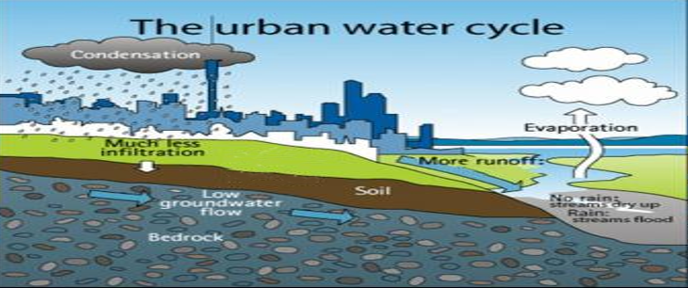
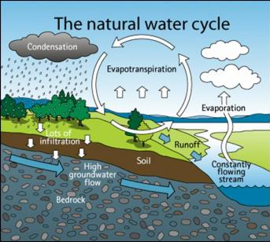
Threats to sustainable waters
Modified from:
Influences on the water cycle in cities through sealed surfaces. Source: AUCKLAND CITY COUNCIL (2010)
http://www.sswm.info/category/concept/water-cycle
Notes:
So how do we make sure that we manage our water resources to promote sustainability?
Local features such as climate/weather, local geology and ecology all affect how watersheds function. However, watershed health also depends heavily on how human activities interact with natural processes.
For example, to replenish our supply of clean freshwater, we rely on natural processes such as infiltration through soils – when precipitation hits the ground in the watershed, it slowly infiltrates into the ground, making its way into the groundwater – and eventually into a stream – and gets filtered through the soil in the process.
Watersheds that include a lot of urbanization – and associated impervious surfaces such as parking lots and buildings – dramatically change how quickly water moves through the system, and what pollutants are carried with the water.

Slide 15
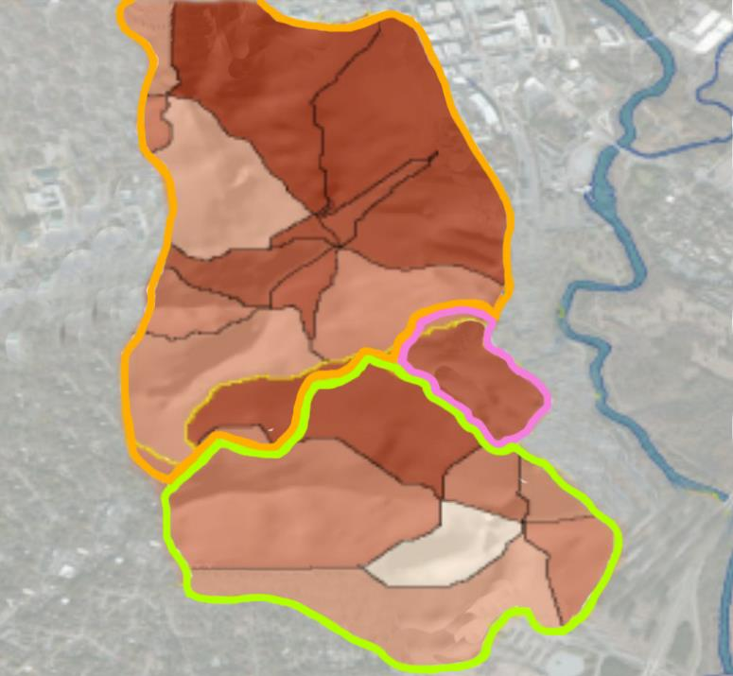
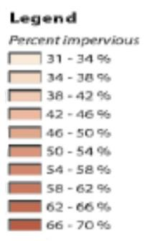
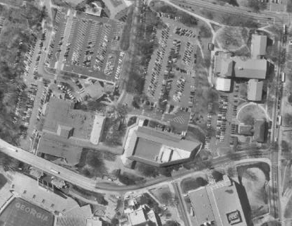
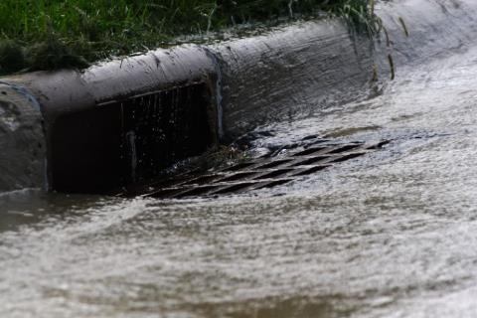
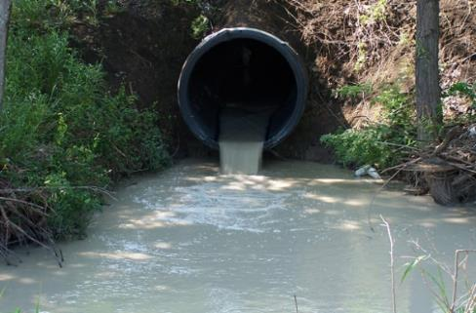
UGA Campus Watersheds
Impervious surfaces…
reduce infiltration of groundwater
increase volume and rate of water entering streams during rain events
stormwater carries pollutants into streams
Notes:
Looking again at the campus watersheds, you see that the vast majority of our campus watersheds are covered with impervious surfaces.
Impervious surfaces are a threat to watershed health because they cause changes in water infiltration rates, and large pulses of water during storms followed by decreased baseline levels of groundwater flowing into streams during dry weather.
Stormwater that runs off of impervious surfaces carries pollutants, including pesticides, fertilizer, sediment, heavy metals and pet waste from roads, parking lots, and lawns into the stream.
Some experts say that having 5% of the land in a watershed be covered by impervious surfaces is a threat to watersheds, - in our campus watersheds, we have 30% impervious surface cover at minimum! Therefore, reducing the amount if impervious cover in our campus watersheds might be an important goal for improving the health of campus streams.
Pipe picture: http://www.deepzine.com/site/images/stories/0111/green%20room_articles_.jpg
Storm drain: http://www.deepzine.com/site/images/stories/0111/green%20room_articles_.jpg

Slide 16
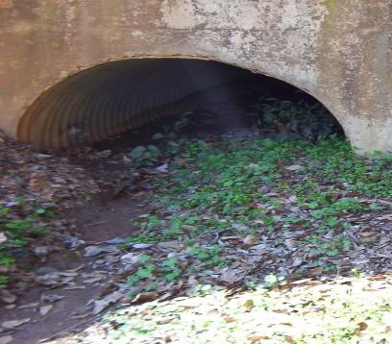
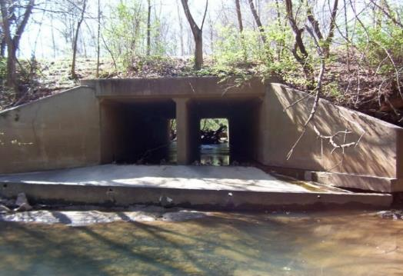
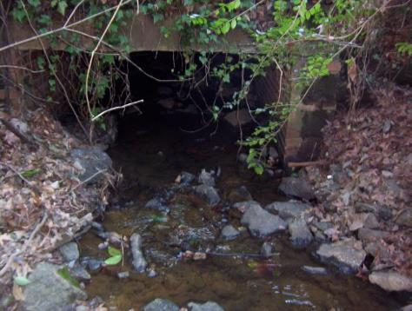
UGA Campus Watersheds
Running underground
in culverts…
“Out of sight out of mind”
reduces primary production by photosynthesizing plants
creates barriers to water flow and to movement between habitats
Notes:
The high amounts of urban development and impervious cover in the UGA watersheds also means that large portions of these streams sometimes run underground in culverts, instead of flowing out in the open, or “daylighting”. When streams flow underground through culverts, we lose our visual connection with them, so we’re less likely to think about protecting them, and we also lose the potential aesthetic and therapeutic value that water provides. Running underground has implications for the life in the streams too – photosynthesis can’t occur in the dark, so algae and plants that form the base of food webs can’t grow in these sections. Culverts also have a tendency to physically interrupt the flow of water in a stream, so that the reaches that are upstream and downstream of the culvert get disconnected when there’s low base flow in the streams.
Approximately two-thirds of Lilly Branch and half of Tanyard Creek flows under buildings and roads in culverts.
Color stream: http://onlineathens.com/stories/112009/new_526820701.shtml#.VSWWk-GVVmM
Lamar Dodd: https://emkarol.files.wordpress.com/2010/09/lamar-dodd-rain-garden.jpg

Slide 17
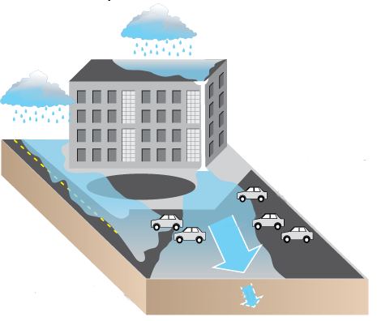
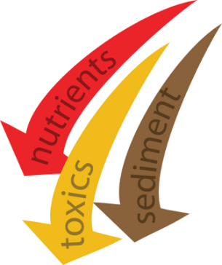
Review of threats to campus watershed health
Water quantity
  Impervious surfaces prevent groundwater recharge from replenishing the water table
  Baseline flow levels decline, or streams can run dry if the water table falls low enough
  High volumes of stormwater runoff can cause erosion of stream banks
Water quality (pollutants)
  Harmful bacteria from pet and human waste
  Oil and heavy metals
  Pesticides and fertilizers
  Sediments
  Heat
http://water.epa.gov/scitech/datait/tools/warsss/type.cfm
Notes:
Everything in a watershed is connected by the water!
This also means that those of us who are upstream have a responsibility to think about what we put into the water, because everything the water picks up in the watershed eventually makes its way from small streams into big rivers, and eventually into the ocean.
Human use often impairs streams in a variety of ways. We alter the hydrologic regime, change runoff consituents, introduce or change pathogen dynamics, and introduce species that can fundamentally alter ecosystem structure. On the UGA campus, invasive species, polluted runoff from impervious surfaces, and leaking sewer lines are all sources of impairment to our three watersheds.

Slide 18
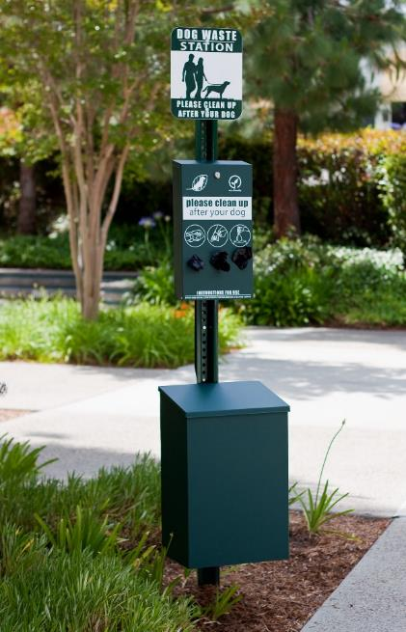
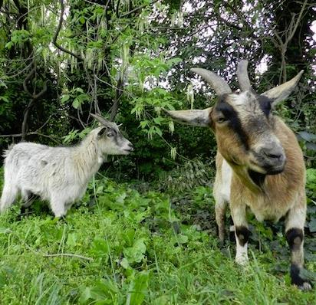
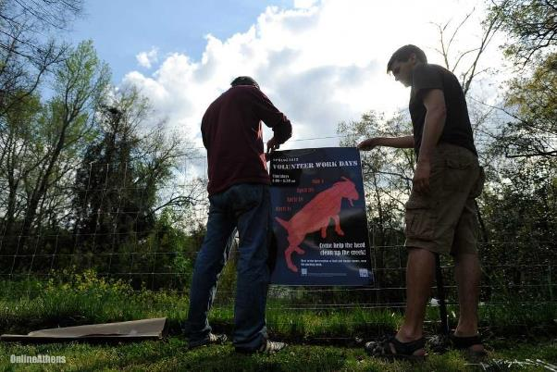
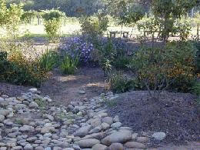
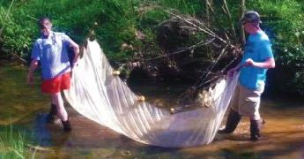
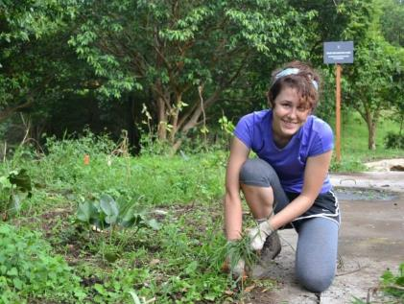
What’s next?
watershed.uga.edu
Notes:
The unhealthy state of our campus watersheds poses “unique challenges and opportunities” for restoration efforts. In collaboration with community partners and Athens-Clarke County officials, a team of students, staff and faculty at UGA have developed a management plan for our campus watersheds, so that we can work as a community towards improving water quality not only here on campus, but for our downstream neighbors who we are connected to by water.
Subsequent class modules will delve into greater detail on both the challenges that campus watersheds face, as well as the opportunities and efforts that are underway to help restore watershed health!
A variety of ideas of how you can be involved are available at watershed.uga.edu
Chew crew: http://weedsnetwork.com/traction/permalink/WeedsNews3186
Waste receptacle: https://www.byoplayground.com/dog-waste-disposal-systems
Invasives pull: http://wyldecenter.org/wylde-center-internships/
http://onlineathens.com/breaking-news/2013-04-09/goats-tackle-invasive-plants-choking-uga-stream-side

